Slide 1

SOC 218
Anthropology
Lecture 9-chapters 17 & 21
These slides contain two short-answers essay questions. These item appears in red

Slide 2
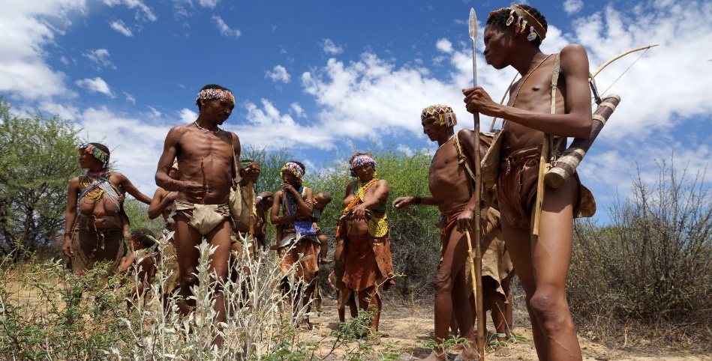
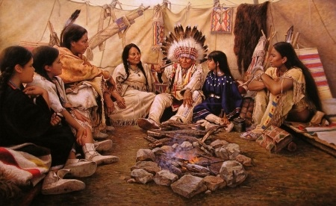
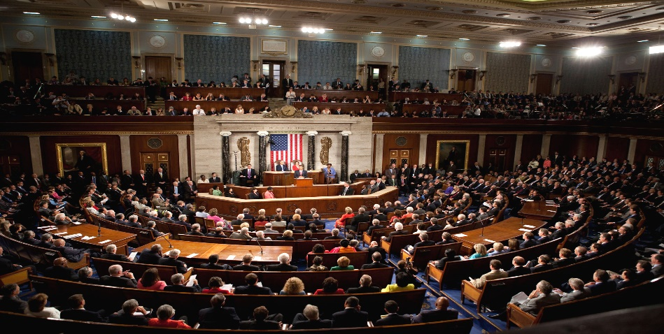
Political Organization
Band
  Kin-based groupings of hunter-gatherers, foragers
      Social control and conflict resolution (see link)
Tribe
  Larger (mobile) groupings bound together by shared territory, property family ties
    Nomadic herding and farming
    Bedouin tribes (see link)
Chiefdom
  Intermediate between tribe and state, bound together in permanent settlements with complex divisions of labor
    Easter Island “Moai” (see link)
State
  Tribes and chiefdom are consolidated into a single contiguous political unit
    Legal, military, & fiscal responsibilities
    US hegemony (see link)

Slide 3
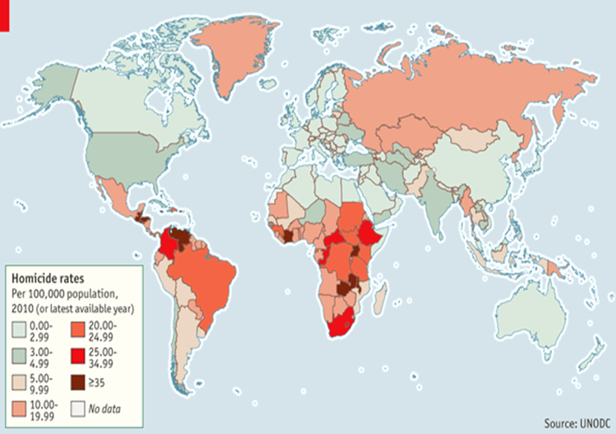
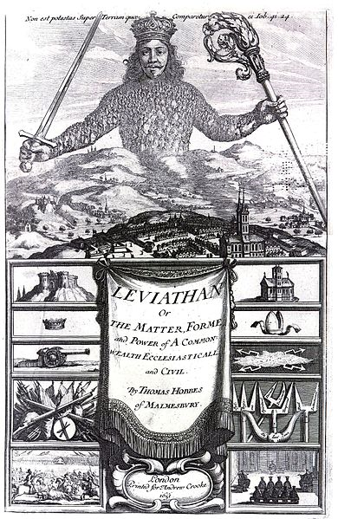
Non-violent means of social control and resistance
  Shame and gossip (see link)
  Weapons of the weak (see link)
  Trends in violence (see link)
Short-Answer Essay 11
  What do you think the chances are that these trends in violence will continue, or will they go in reverse (i.e., violence will increase)? Provide a rationale for your prediction.

Slide 4
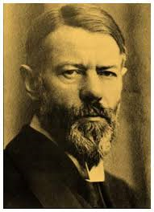
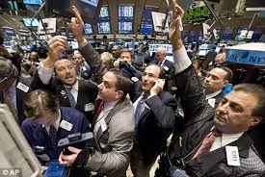
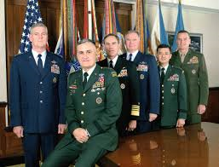
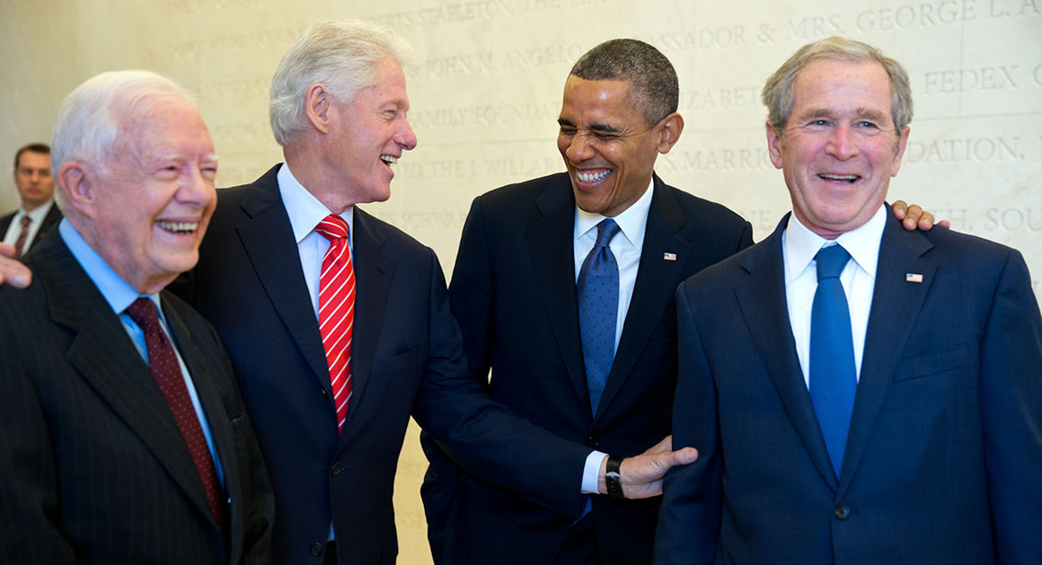
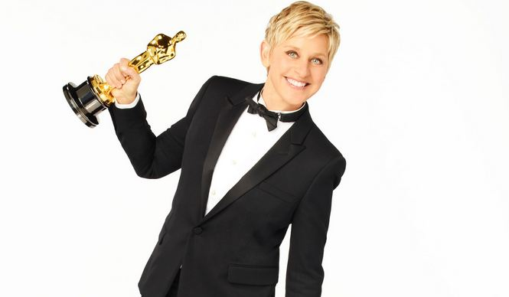
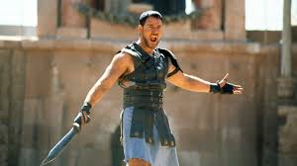
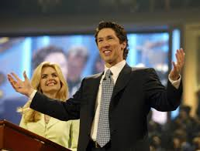
Status and Stratification
Max Weber’s scheme:
  Wealth—economic status
    Bankers, merchants, entrepreneurs
  Power—political status
    Military and political heads, police
  Prestige—social status
    Entertainers, athletes, priests

Slide 5
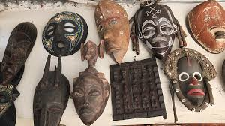
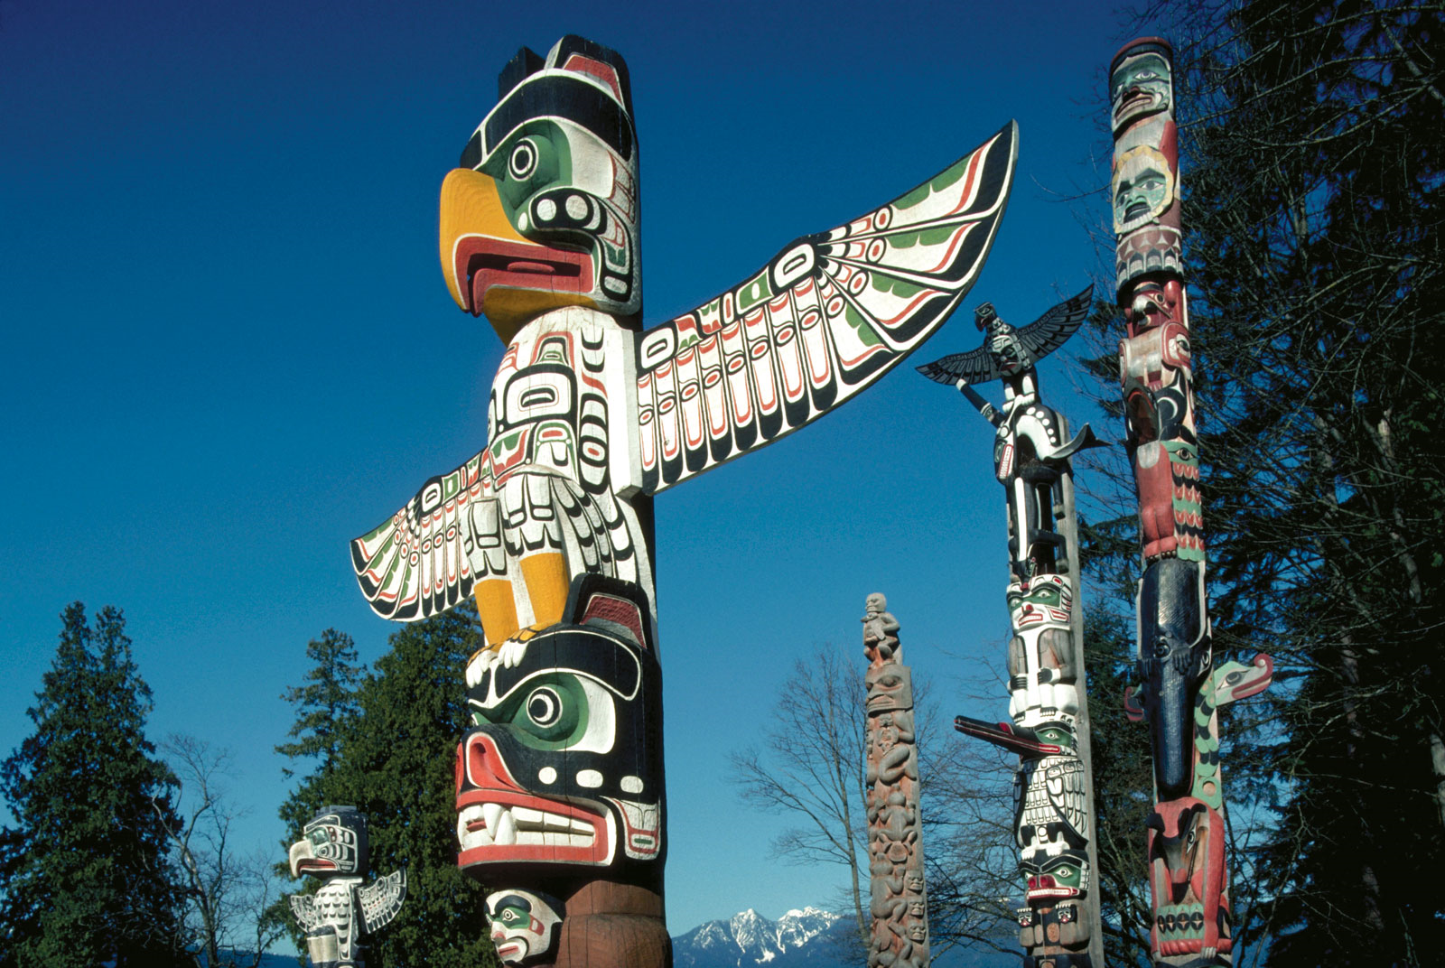
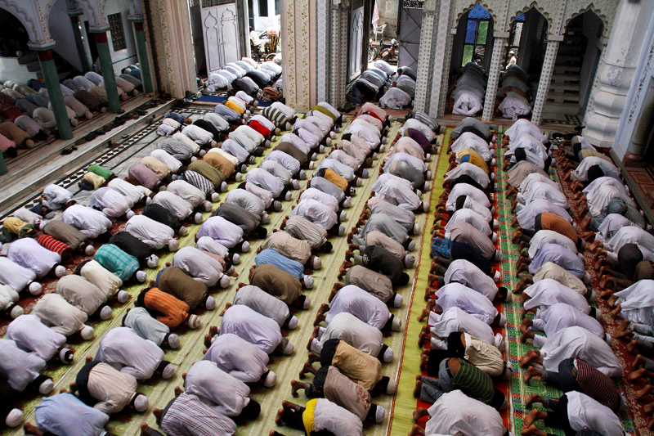
Origins and Functions of Belief
Cosmology
  Animism
    Spirit beings, nature gods, household gods, ancestral gods
      Characteristic of small bands of hunter-gatherers (see link)
  Totems
    Characteristic of some tribes
      Theory of belief (see link)
  Magic and Witchcraft
    Mexican shamans (see link)
Provide social cohesion
  Rituals and Rites of Passage
    Build devotion and solidarity
      Religious attendance, prayer
        Praying in tongues (see link)
    Secular rituals
      meditation, yoga

Slide 6
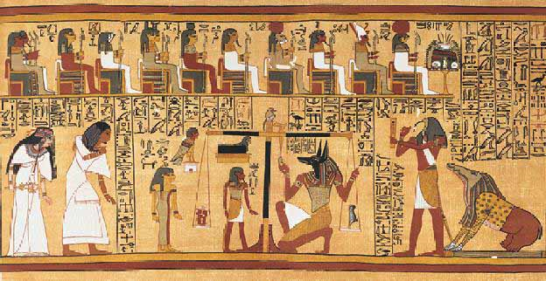
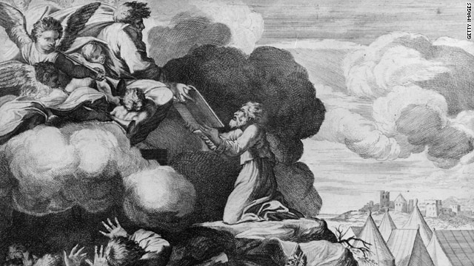
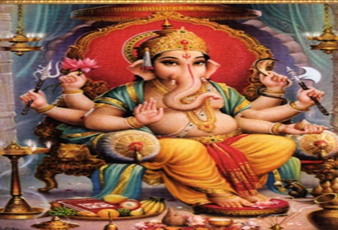
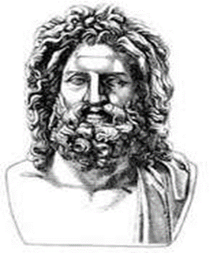
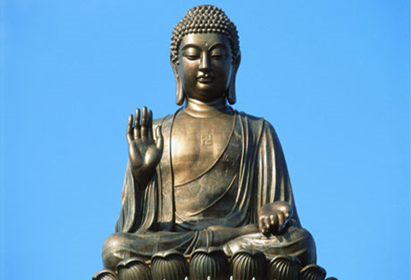
Gods and Religion
Polytheism
  Regional gods, gods to represent each ethno-cultural groups
    Characteristic of tribal societies and chiefdoms
Monotheism
  All powerful god that is the paragon of virtue and source of morality
    Judaism , Christianity, Islam,
      Characteristic of states and empire
“Conscious and moral” gods
  Western religions & Hinduism
“Amoral gods”
  Greco-Roman gods
“Godless” religions
  Taoism, Confucianism, Buddhism

Slide 7
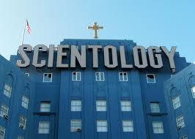
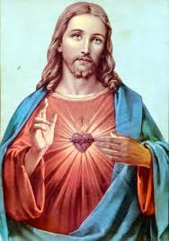
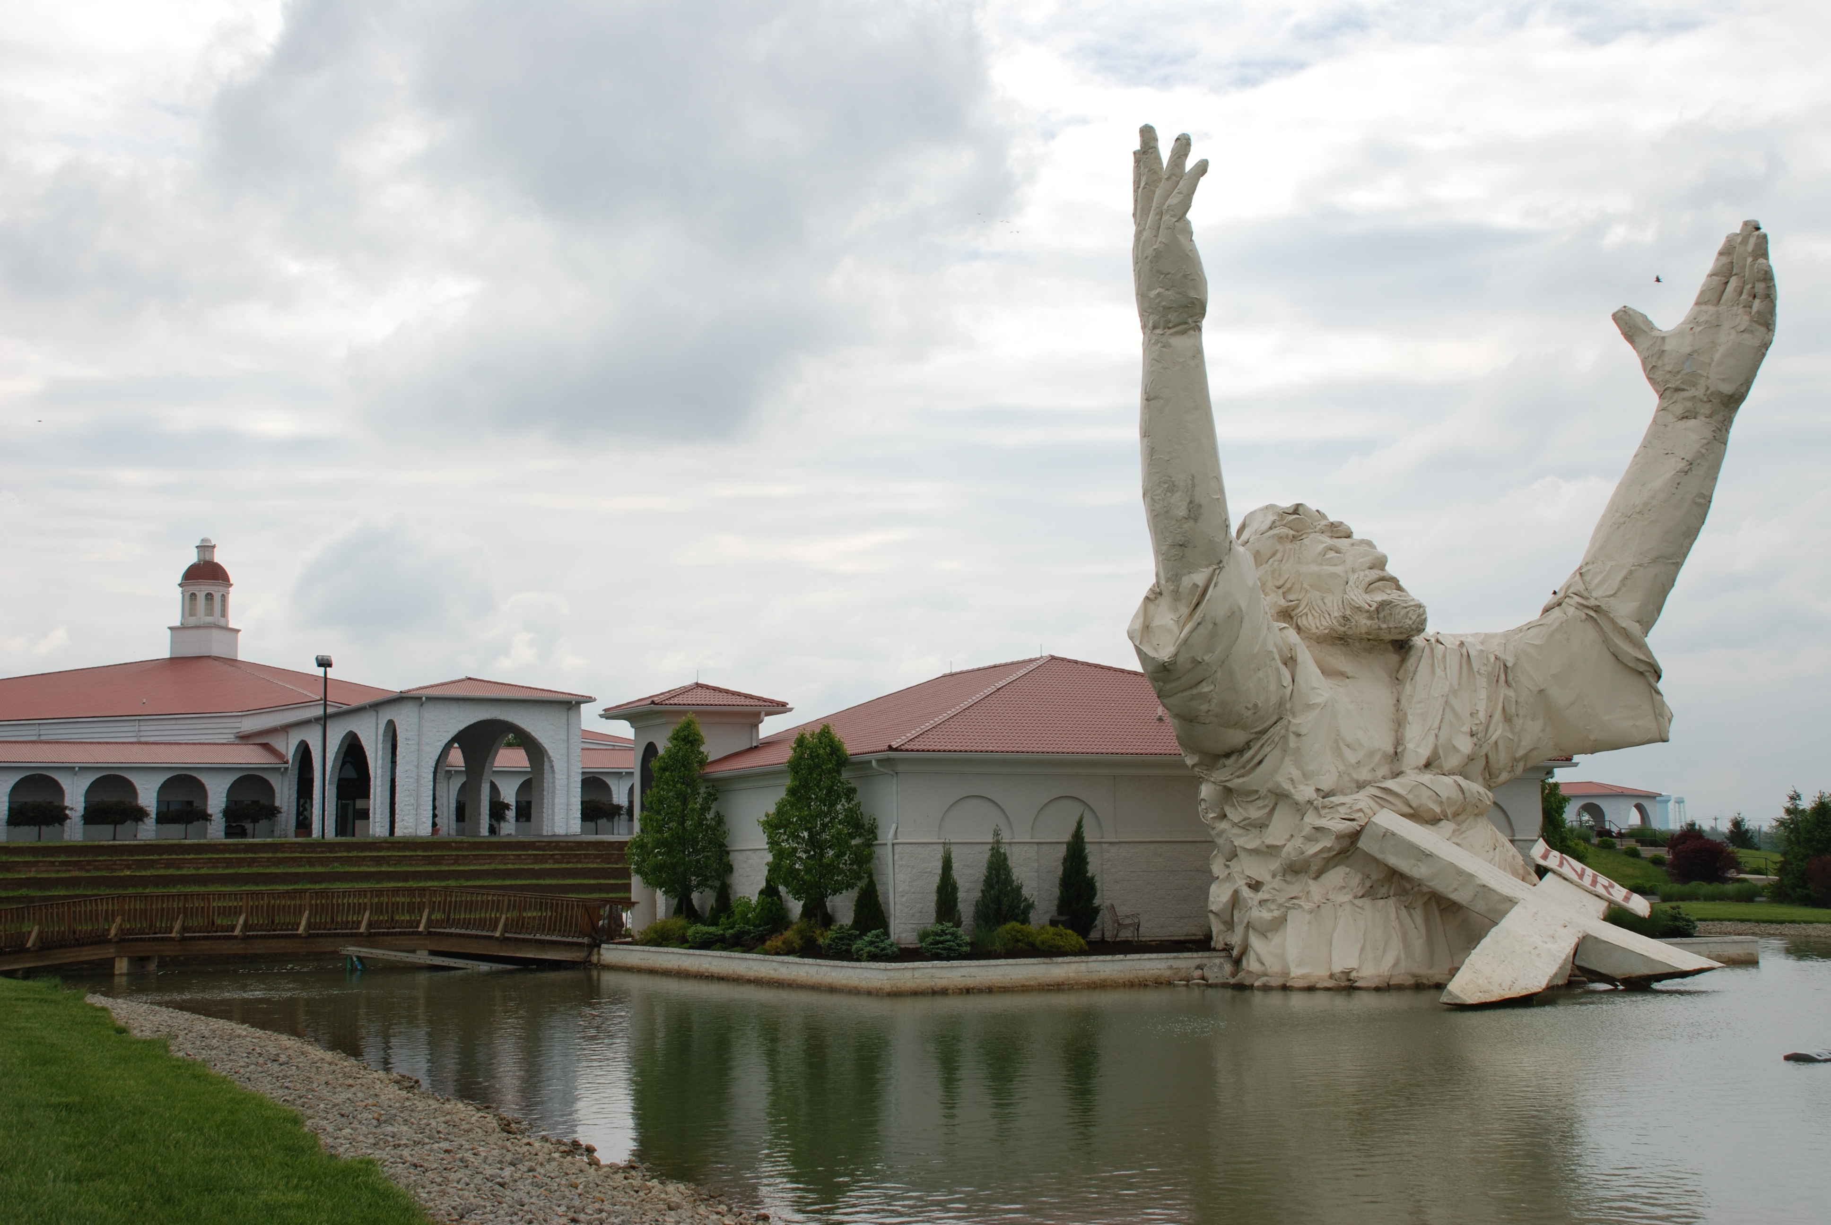
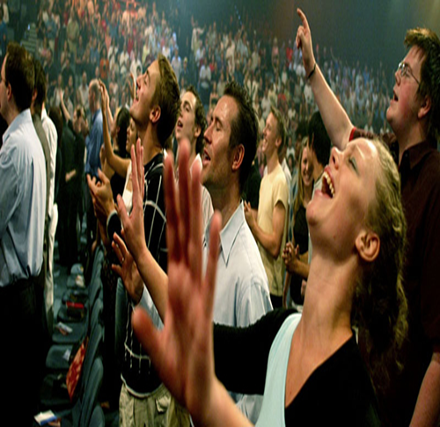
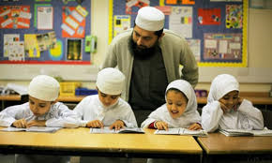
Religious Change
New and Alternative Religions
  Cults
    Charismatic leaders
  Sects
    Protestant Reformation (see link)
Revitalization movements
  Evangelical Christians
    Pentecostalism (see link)
Fundamentalism
  Spread of Islam (see link)
Short-Answer Essay-Bonus
  Can European natives and Muslim immigrants reconcile their cultural differences, or will Europe decide to limit Muslim immigrants entering its borders?

